Slide 1

The STL, std string and more I/O
Lecture 9
Data Structures and Abstractions

Slide 2
What is the STL? [1]
When C++ was written it was essentially a superset of C that allowed object-oriented programming.
At the start people either used the C-style arrays and strings (that we have already looked at and revised) or created their own classes.
This was patently silly, so in the mid 1990s a standard set of templates was created for commonly used structures that are containers of data. [2]
A container stores multiple objects of the same type. What changes between different types of container is the type of access, ordering and methods available.
In this unit we will examine some of the most commonly used STL containers.
Notes:
[1] STL is not the same as the template classes that you will have to write. STL is a library (Standard Template Library) that uses templates and is already available.
[2] The idea for this existed in the 1970s for other languages.

Slide 3
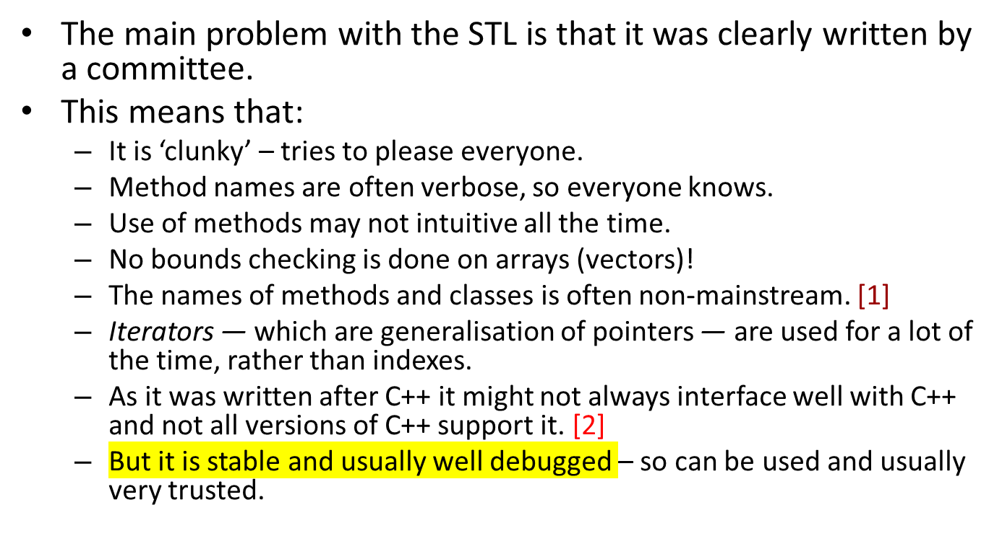
Problems with the STL
Notes:
[1] See the reference text, Introduction to Algorithms. Look at the chapters on data structures.
[2] But see the C++11 standard, C++14, C++17, C++20

Slide 4
The standard string class (C++)
ANSI/ISO standard for C++ requires a string class to be a basic data type.
Programmer should not have to worry about implementation details of the string class.
It is part of the std namespace. [1]
Is not part of C++ (as in reserved word); it is a programmer defined type available in the standard library.
It has a wealth of good functions that make string handling much simpler.
It has overloaded operators so that you can do such things as add to a string using the + operator.
It makes reading in a whole line of text (including spaces) trivial.
To use the standard string you must include the header file <string>.
Notes:
[1]
You may recall that cin and cout are also part of the std namespace.
Writing
using namespace std;
Exposes the entire std namespace – not a good idea as the namespace is used as an encapsulation tool. But we are exposing the whole std namespace for convenience. Find out about namespaces see back index in your textbook.

Slide 5
The std string
Unlike a C-style string, an std string cannot overflow.
However, no bounds checking is done on access.
Do not assume that std string is NULL terminated. [1]
Access to the string can be done as per any other string, using the [] operator.
There are many good websites giving information on the various aspects of C++ including the std string.
The following site is recommended. http://www.cppreference.com/cppstring/index.html
Notes:
[1] You shouldn’t even assume or worry how a std string is stored.

Slide 6
String Operator List
In each of the examples below, str1, str3 and str4 must be std strings, however str2 can be a c-style string. // std:string str1, str3, str4 [1]
str1 = str2 | Copies str2 to str1
str1 == str2 str1 < str2 str1 > str2 | These give true or false depending on whether str1 is lexicographically equivalent to, less than or greater than str2.
str1 = str3 + str4 | str1 becomes the concatenation of str3 and str4.
str1 += str2 | str2 is appended to str1
str1 += ch | The character ch is appended to str1
cout << str1 | str1 is output to screen
cin >> str1 | The first word typed at the keyboard is stored in str1
Notes:
[1] Mixing an std string with a C-style string would in theory cause type conflicts.
For a C-style string to occur in the same expression as a std string, implicit type conversion must happen.
So, there is a std string constructor which converts a C-style string to a std string.

Slide 7
Std::string methods
Each method is overloaded multiple times.
For example, to append to a string you could use:
str1.append (str2) | Appends str2 to the end of str1, where str2 can be a c-style OR std string.
str1.append(str2, index, num) | Append num characters from the part of str2 that starts at index.
str1.append (str2, num) | Append num characters from the start of str2, where str2 can be a c-style or std string.
str1.append (num, ch) | Add num repetitions of ch to the end of str1.
str1.append (itr1, itr2) | Append the string that starts at iterator itr1 and ends at iterator itr2.

Slide 8
List of Commonly Used Methods
<various> below indicates that the method is overloaded and there are various possible parameters.
For more information, go to http://www.cppreference.com/cppstring/index.html
or your text book.
str1.append (<various>) | Append values str1.
str1.c_str () | Returns a standard c-style string (char *). Required for file opening etc.
str1.clear () | Empties the string.
str1.compare (<various>) | Compares two strings.
str1.copy (<various>) | Copies data into str1.
str1.empty () | Returns true if the string is empty.
str1.erase (<various>) | Erases a part of the string.

Slide 9
Methods (continued)
str1.find (<various>) | Finds strings or characters within str1.
str1.rfind (<various>) | Finds strings/characters within str1, searching from the end.
str1.insert (<various>) | Inserts strings or characters into str1.
str1.length () str1.size () | Return the length of the string (number of objects in it)
str1.push_back (ch) | Add the character to the end of the string.
str1.replace (<various>) | Replace strings/characters within str1.
str1.substr (index, num) | Returns num characters starting from index.
str1.swap (str2) | Swaps the two strings.

Slide 10
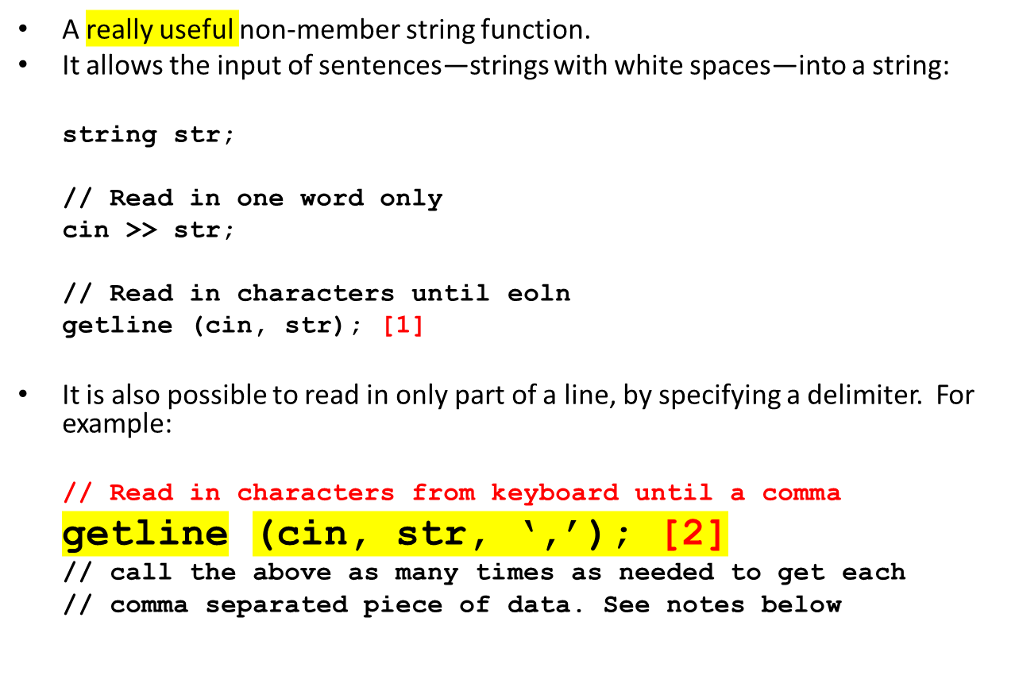
The getline Function
Notes:
[1]
Use cin.getline(..) for reading in char arrays. The getline shown above is the std::getline(…) and it allows you to read in a std::string object.
[2]
See section on “iostreams and getline()” at
http://www.cplusplus.com/faq/sequences/strings/split/ - You need to scroll down a bit. But the discussion on splitting strings is also useful for later work, lab 4 and the assignment.
Note that the delimiter is ‘,’ so that means that the newline /n is no longer the delimiter when reading in from a file infile
getline(infile, s, ','); // string s;
The result when reading the last string on a line would mean that string s would contain, the last string field of the previous line, the newline character and the first string field of the next line.
To get around this problem, read the entire line in with
getline(infile, s); // s will contain the whole line with no newline, which is what you want.
You can read the entire file line-by-line using a while loop.
while(getline(infile,s)){
….. // now split line s using delimiter as string s doesn’t have the newline to mess things up.
}
Alternatively:
while(infile.good()) { // don’t use .eof as it only checks for one condition only – see below
getline(infile,s);
cout << s<< endl; // Print it and see that you are getting it right first
….. // now split the line in s using delimitter
}
.eof doesn’t detect other file issues. See table at https://www.cplusplus.com/reference/ios/ios/good/
Then start splitting the whole line string s. You can write code to manually check for the delimiter and split, or you can work at a higher level using helper classes like stringstream that converts a string into a stream for I/O purposes (i.e. read/write is done on streams). Textbook readings has details.
So convert the string object s containing the whole line into a string stream (i.e. a stringstream object).
The stringstream interface is available by #include <sstream>
stringstream ss(s); // the line string is now constructed into a stringstream object.
You can now read from the stringstream object ss using the getline function with the needed delimiter:
Splitting each line using the comma delimiter:
while (getline(ss, field, ',')) { reads from ss into a string field
cout << field << endl; // Print it and see that you are getting it right first
… do whatever you want with string field.
}
http://www.cplusplus.com/reference/string/string/getline/
http://www.cplusplus.com/reference/istream/istream/getline/

Slide 11
Using Iterators
All of the STL uses iterators for access to data. The same is true for std string.
For this reason, there are two functions that are standard for each container in the STL:
.begin() | Returns an iterator pointing at the first object in the container.
.end() | Returns an iterator pointing at the first memory location past the end of the container.

Slide 12
#include <string>
#include <iostream>
using namespace std;
int main()
{
string str;
cout << "Enter a string: ";
getline (cin, str);
cout << endl
<< "The characters in your string were: "
<< endl;
cout << endl;
return 0;
}
Simple string access program
Uses the normal index type access method
for (int index = 0; index < str.length(); index++)
{
cout << str[index] << endl;
}

Slide 13
#include <string>
#include <iostream>
using namespace std;
int main()
{
string str;
cout << "Enter a string: ";
getline (cin, str);
cout << endl
<< "The characters in your string were: "
<< endl;
cout << endl;
return 0;
}
Simple string access program
Uses the iterator type access method
for (string::iterator itr = str.begin();
itr != str.end(); itr++)
{
cout << *itr << endl;
}

Slide 14
Testing
Always test for:
  empty strings;
  empty files;
  incorrect file names;
  read-only files.
Only assume data is correct if you have it stated in writing.
Never assume the user won’t make a mistake.
Always have a test plan and run through it every time you alter the program in any way.

Slide 15
Text File I/O
A name must be entered by the user.
The file must be opened.
A test must be done to check it has opened.
Data is then read until EOF.
File handling in C++ requires the <fstream> header file. See the lab exercises starting in topic 2.

Slide 16
// text.cpp
// Text file I/O
// Reading a file of integers separated by spaces or new lines
//
// Version
// 01 - Nicola Ritter
// 02 – modified smr
//--------------------------------------------------------------------
#include <iostream>
#include <fstream>
using namespace std;
//--------------------------------------------------------------------
const int SIZE = 256;
typedef char strType[SIZE+1]; // name the type
//--------------------------------------------------------------------

Slide 17
int main ()
{
strType filename; // C array of chars
// Get a file name from the user
cout << "Enter name of file to read (one word only): ";
cin >> filename;
// Declare the file variable and try to open it using that
// file name
ifstream fstr (filename);

Slide 18
// Is the ready state 0 (no errors)?
if (fstr.rdstate() == 0) //[1]
{
int number;
// prime the while loop
fstr >> number;
while (!fstr.eof())
{
cout << number << endl;
fstr >> number;
}
}
else
{
cerr << "Could not open file \"" << filename
<< "\" for reading." << endl;
}
return 0;
}
Notes:
[1] http://www.cplusplus.com/reference/ios/ios/rdstate/

Slide 19
Opening Files using std string
string filename;
cout << “Enter filename: ”;
getline (cin, filename);
ifstream fstr (filename.c_str());
// The rest of the code is the
// same as before
File names can now contain spaces
str.c_str()
can be also be used with some of the standard c-style string functions
c_str()
gives the required access to the actual character string

Slide 20
More About File I/O
Opening a file for output is done in a similar way, except that it will be an output file stream:
ofstream fstr (filename);
To append to a file, you would open it with:
ofstream fstr (filename, ios::app);
When you are going to store more of one type of data in a file, it is necessary to store the number of each type. You don’t have to but this can cause problems in designing the algorithm. Algorithm would require asking the user or the value is hard coded.
For example, when storing an array of 100 integers, you would write the 100 to the file first.
When reading the file, you would then read the number 100 and therefore know that you had 100 integers to read.

Slide 21
Other Useful I/O Functions
There are several generically useful I/O functions (as well as the formatting ones done previously) [1]:
cin.good() fstr.good() | Returns true if the stream (standard input or a file stream) has no errors.
.flush() | Flushes (empties) the stream (but not the actual file!).
.peek() | Peek at the next character without actually reading it.
.ignore () | Ignore characters
Notes:
[1]
http://www.cplusplus.com/reference/ios/

Slide 22
Readings
Topic Reading List
Textbook:
  Chapter on Arrays and String, Section on C-Strings.
  Chapter on User-defined Simple Data Types, Namespaces, and the string type, section on string type.
  Chapter on Standard Template Library (STL)
Website: http://www.cplusplus.com/faq/sequences/strings/split/
Website: “Iterators”, https://www.geeksforgeeks.org/introduction-iterators-c/ - optional
Video by Standford uni provided by academicearth. Links:
  C/C++ Libraries explains string operations
  C++ Console I/O

